Slide 1
Preparing for Aspire: What Do You Need to Know?
April 2015

Slide 2
Essential Question
What aspects of the ACT Aspire test do I need to know to be prepared?

Slide 3
Concerns
Formatting details
Carefully reading instructions
Multiple choice formats
When to move on
Not finishing the test – random bubbling
Writing process in 30 minutes
Timed testing anxiety

Slide 4
Reading test NTKs
Formatting of passage
Formatting of questions
Skimming questions to read with intention
Answer sheet format
Multiple choice options (A-J)
Constructed Response
Not finishing

Slide 5
Every five lines are numbered

Slide 6
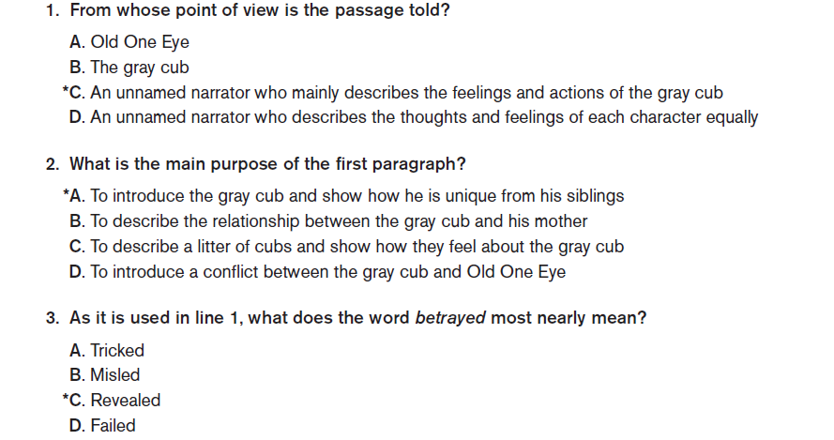
Question format and cues
Guidance to a specific paragraph
Guidance to a specific line, but they may need to read more
for full context

Slide 7
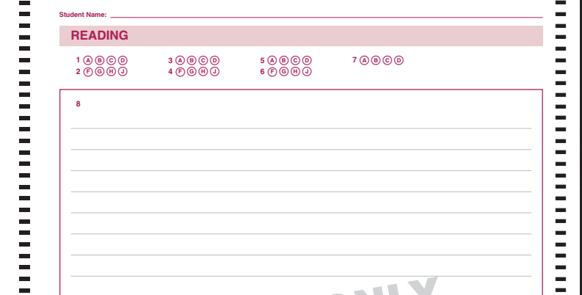
Reading Test Answer Sheet
Notice direction
of questions
Constructed response space –
one page

Slide 8
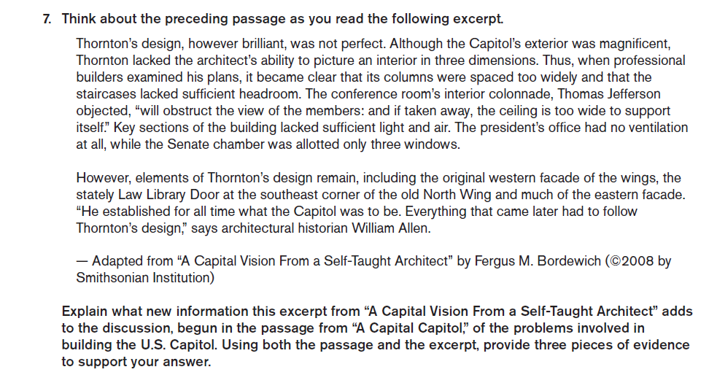
Constructed Response (Complex)

Slide 9
Constructed Response (Simple)
Explain why scientists are interested in studying the monarch butterfly. Provide two details from the passage to support your answer.

Slide 10
Guidance for Constructed Response
Know what the prompt is asking you to do
Include the specific number of details required by the prompt or full credit will not be awarded
Respond in a sentence to EXPLAIN, but your details and evidence may be bulleted or numbered.

Slide 11
Guidance for Reading Passages
Skim the questions first to get a sense of what you are looking for
No idea how to answer question – move on
Return to unanswered questions when there are just a few minutes left in the reading test
No penalty for guessing

Slide 12
English Test NTKs
Formatting of passage
Formatting of questions – correlation to elements in the passage
Multiple Choice options (A-J)
May be subtle differences between options
Read for key words, such as BETTER choice or CORRECT choice, most LOGICAL placement…
NO CHANGE is a viable option

Slide 13
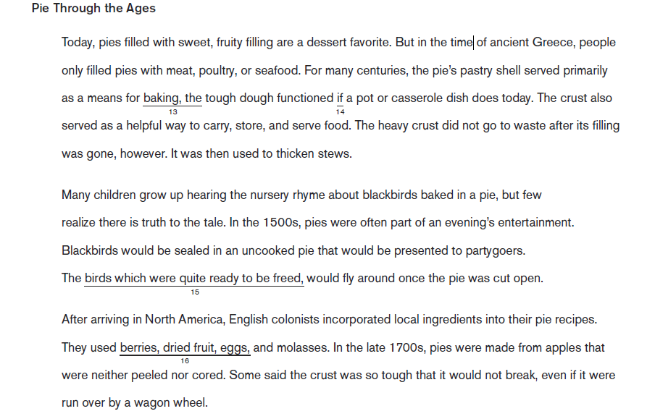
Underlined section correlates to question number

Slide 14
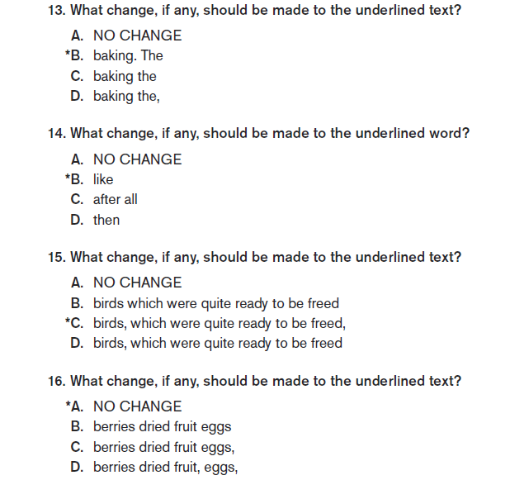
Questions are correlated to the underlined
numbers on the passage

Slide 15
Another Format-Combination of Numbers and Letters
Some passages will have numbered paragraphs
These letters and
paragraph numbers are part of the question

Slide 16
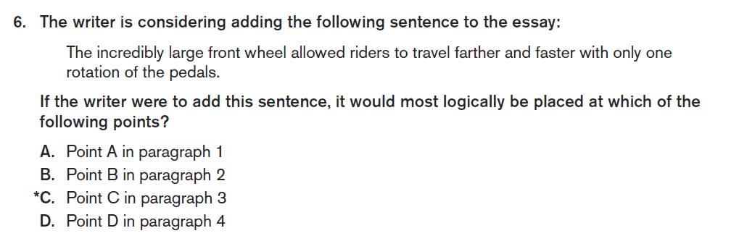
Revision Questions May Use Letter Reference Points

Slide 17
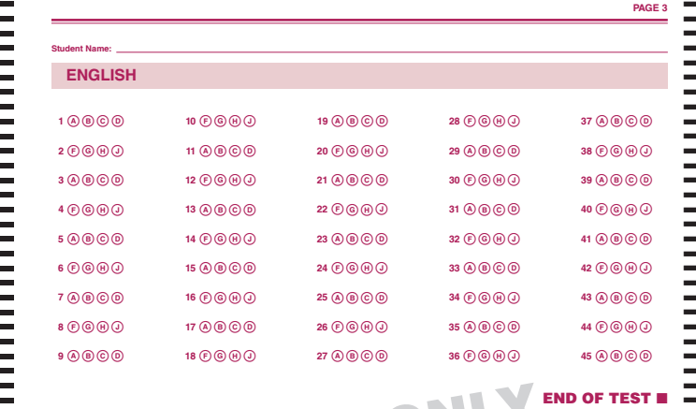
English Test Answer Sheet
Direction of questions

Slide 18
Tips for English Test
Some questions may not require you to read the passage in detail (editing), while others may ask you to revise (which requires a careful read)
Numbers and Letters embedded in the passage matter – they are the map for the questions
No Change indicates the sentence is correct in the passage – don’t assume it is not a viable option

Slide 19
Writing Test NTKs
3rd grade – Reflective narrative
4th grade – Analytical expository
5th grade – Persuasive/argument
Response written in test booklet (organizational pre-writing not scored and not included in test booklet)

Slide 20
Writing Test

Slide 21
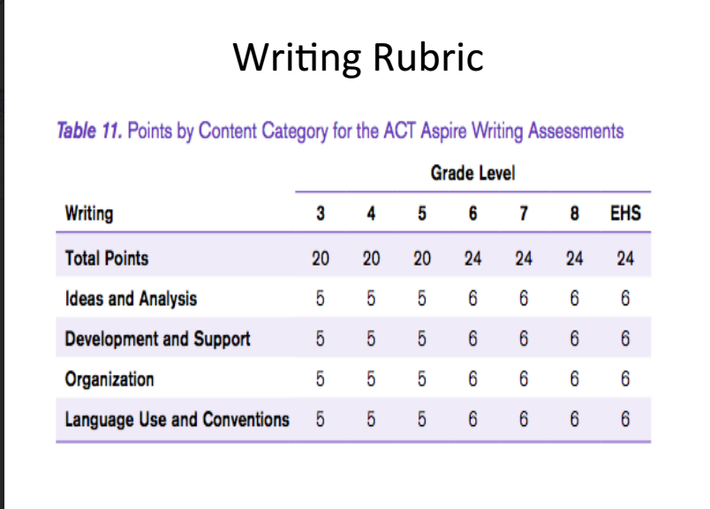

Slide 22
Tips for Writing Test
Number of paragraphs is not definitive – some topics do not lend themselves to 5 paragraphs
Encourage time spent on organizing thoughts before writing
Time management is left to them – turn on their internal clock
Legibility is important

